Slide 1
Value Added
Lessons on Home Price Patterns from Ames, IA:
Proven trends and Overlooked Features

Slide 2
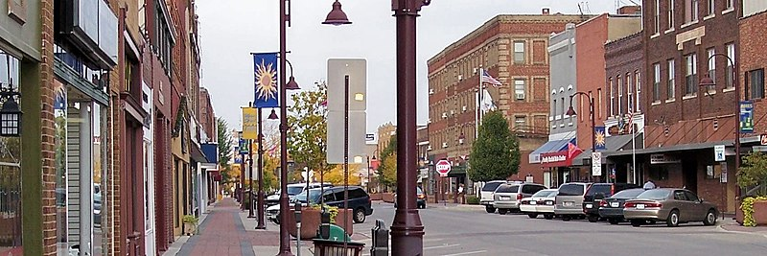
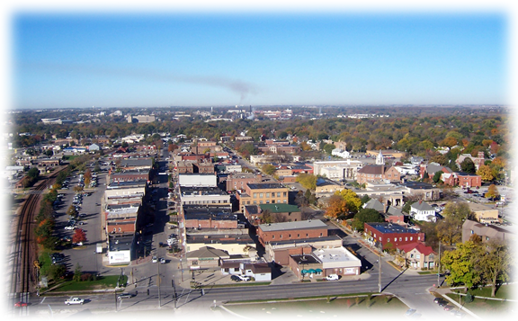
How Can We Compare?
Our study is Ames, Iowa
2019 Population: 66,258
Known as a college town.
Easy to find useful trends in home prices.
Comparable to other cities and towns when we model thoroughly.
Source: https://www.census.gov/quickfacts/amescityiowa

Slide 3
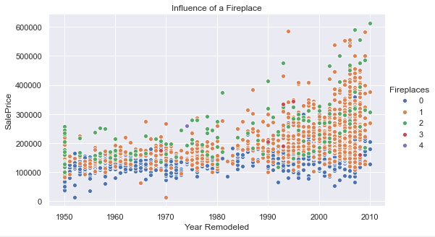
Simple Features, Large Impact:
There is a noticeable jump in a home’s price by just having at least one fireplace.
Source: http://jse.amstat.org/v19n3/decock/DataDocumentation.txt

Slide 4
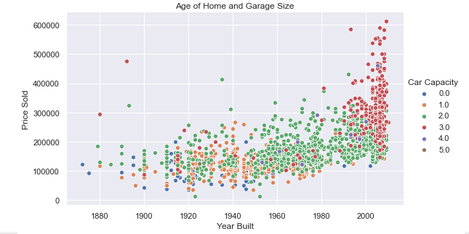
Simple Features Contd:
Newer and larger garages by Car Capacity win at price as we might expect.
Source: http://jse.amstat.org/v19n3/decock/DataDocumentation.txt

Slide 5
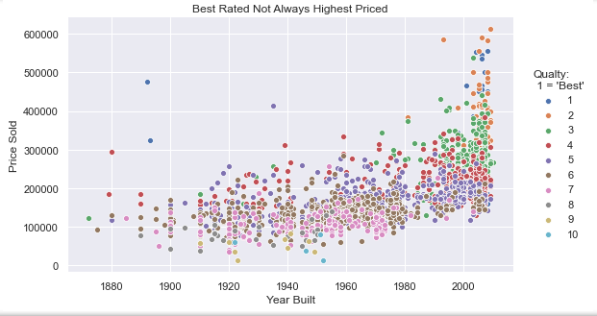
Features Contd: Obvious and Interesting
There are some interesting exceptions to the overall quality rating of a home compared to its price.
A home doesn’t need to be the highest rank in quality to be more expensive.
Source: http://jse.amstat.org/v19n3/decock/DataDocumentation.txt

Slide 6
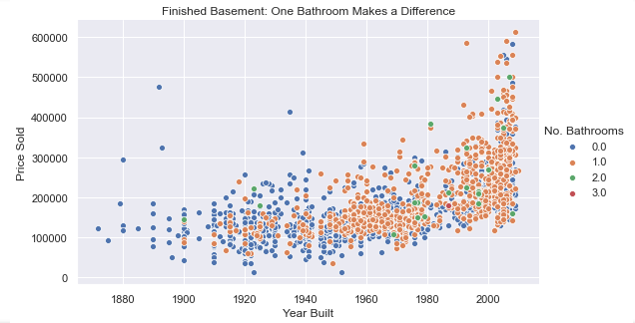
Basements: Easy Features to Consider:
Simply having 1 bathroom in a finished basement dramatically improves sale price.
Source: http://jse.amstat.org/v19n3/decock/DataDocumentation.txt

Slide 7
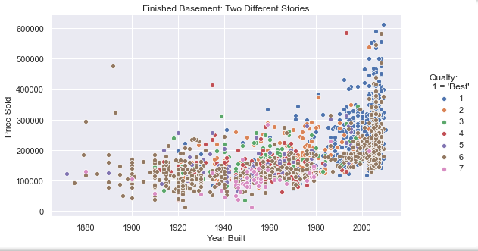
Basements Contd:
Overall finished basement quality goes the extra mile for a home having a high value.
Source: http://jse.amstat.org/v19n3/decock/DataDocumentation.txt

Slide 8
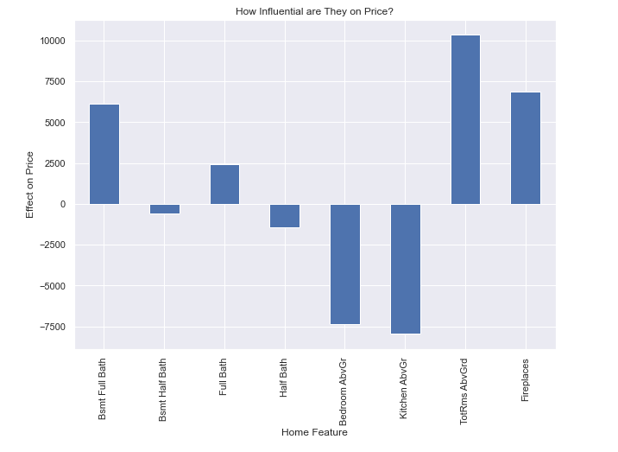
How sensitive is our price to these Features?
Source: http://jse.amstat.org/v19n3/decock/DataDocumentation.txt

Slide 9
Outside Ames:
Can we be confident that these patterns hold outside of Iowa?
Models were run based on the data collected from Ames on new data outside of Ames.
Above 75% of the variation in a home’s sale price outside of Ames was reasonably explained by the regression model created from what we observed in Ames.

Slide 10
Conclusions:
A newer home will be seen as more valuable, no surprises there.
Simple features in a home can make a large difference in price.
One fireplace or bathroom in a basement can make a significant difference.
Not all the features influence price positively and some are very influential in the opposite direction.
Good starting point for considering what can make a home valuable elsewhere.

Slide 11
Thank You

